Slide 1


Team- 4
Project Tittle: Credit Card Fraud Detection
Team Members:
Afnan Anwar Khan - AXA230028
Bhavya Narendrabhai Patel - BXP220032
Niranjan Arkadu - NXA230011
Rohit Narayanan - RXN230020
Trung Nguyen - TBN140130

Slide 2
Credit Card Fraud Detection: A Machine Learning Approach
This presentation explores a machine learning project for detecting credit card fraud. We'll examine data analysis, model selection, and evaluation techniques to combat financial crime effectively.

Slide 3


Motivation and Project Focus
1
Financial Impact
2
Consumer Trust
3
Technological Challenge
Effective fraud prevention enhances customer confidence in digital payment systems. This drives e-commerce growth.
Fraudsters constantly evolve tactics. Advanced ML models are crucial for staying ahead.
Credit card fraud costs billions annually. Machine learning offers a powerful solution for real-time detection.

Slide 4


Dataset Introduction and Preprocessing
1
Data Source
Obtained credit card transaction data from Kaggle. Contains x No. of transactions.
2
Cleaning
Removed duplicates and standardized formats. Handled missing values through imputation techniques.
3
Feature Engineering
Created new features like transaction frequency and amount deviation. Enhanced model's ability to detect anomalies.

Slide 5
Exploratory Data Analysis (EDA)
Transaction Distribution
Feature Correlations
Class Imbalance
Analyzed transaction amounts and time patterns. Found most fraudulent transactions occur at night.
Identified strong correlations between certain features and fraud likelihood. Time and amount were key.
Only x% of transactions were fraudulent. This posed a significant challenge for model training.

Slide 6


Addressing Data Imbalance
Random Oversampling
SMOTE
Duplicated minority class samples to balance the dataset. Simple but risked overfitting.
Generated synthetic samples of the minority class. Improved model generalization on new fraud cases.
Undersampling
Reduced majority class samples. Faster training but risked losing important information.

Slide 7
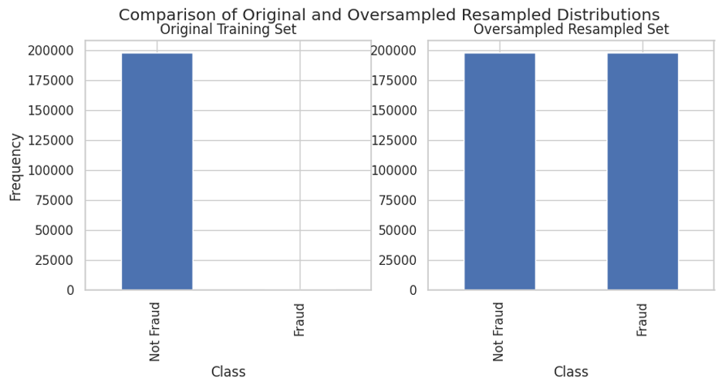

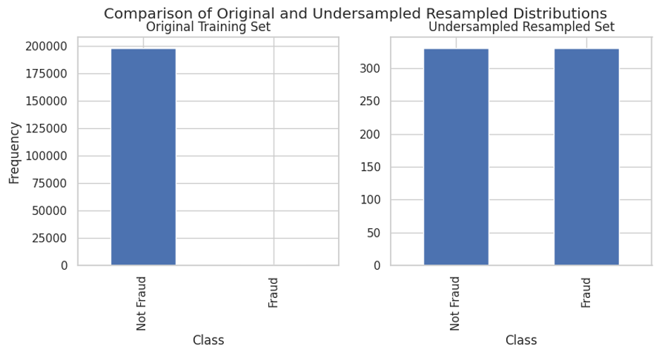

Slide 8


Model Selection and Training
Model
Strengths
Weaknesses
Logistic Regression
Interpretable, fast
Limited complexity
Random Forest
Handles non-linearity, feature importance
Black box nature
XGBoost
High performance, regularization
Prone to overfitting

Slide 9

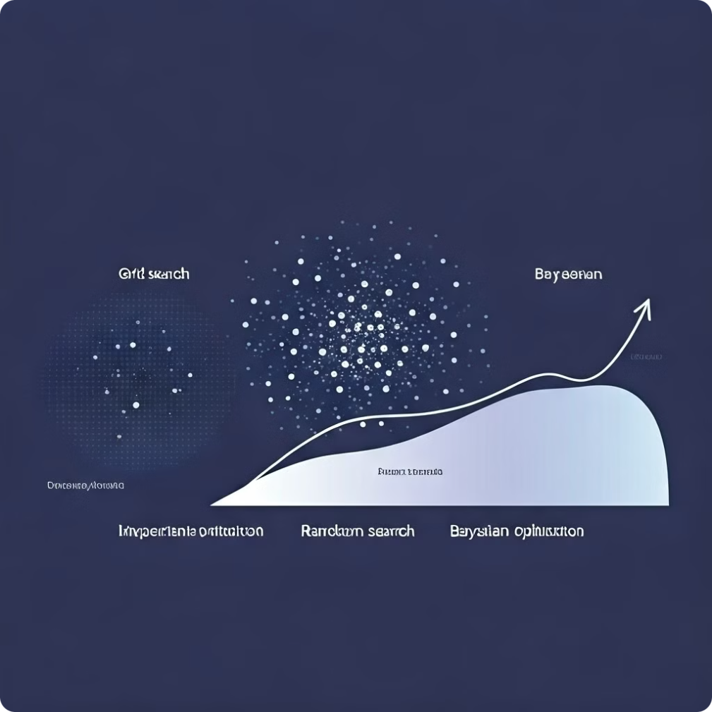

Hyperparameter Tuning
Grid Search
Exhaustively searched predefined parameter ranges. Computationally expensive but thorough.

Slide 10


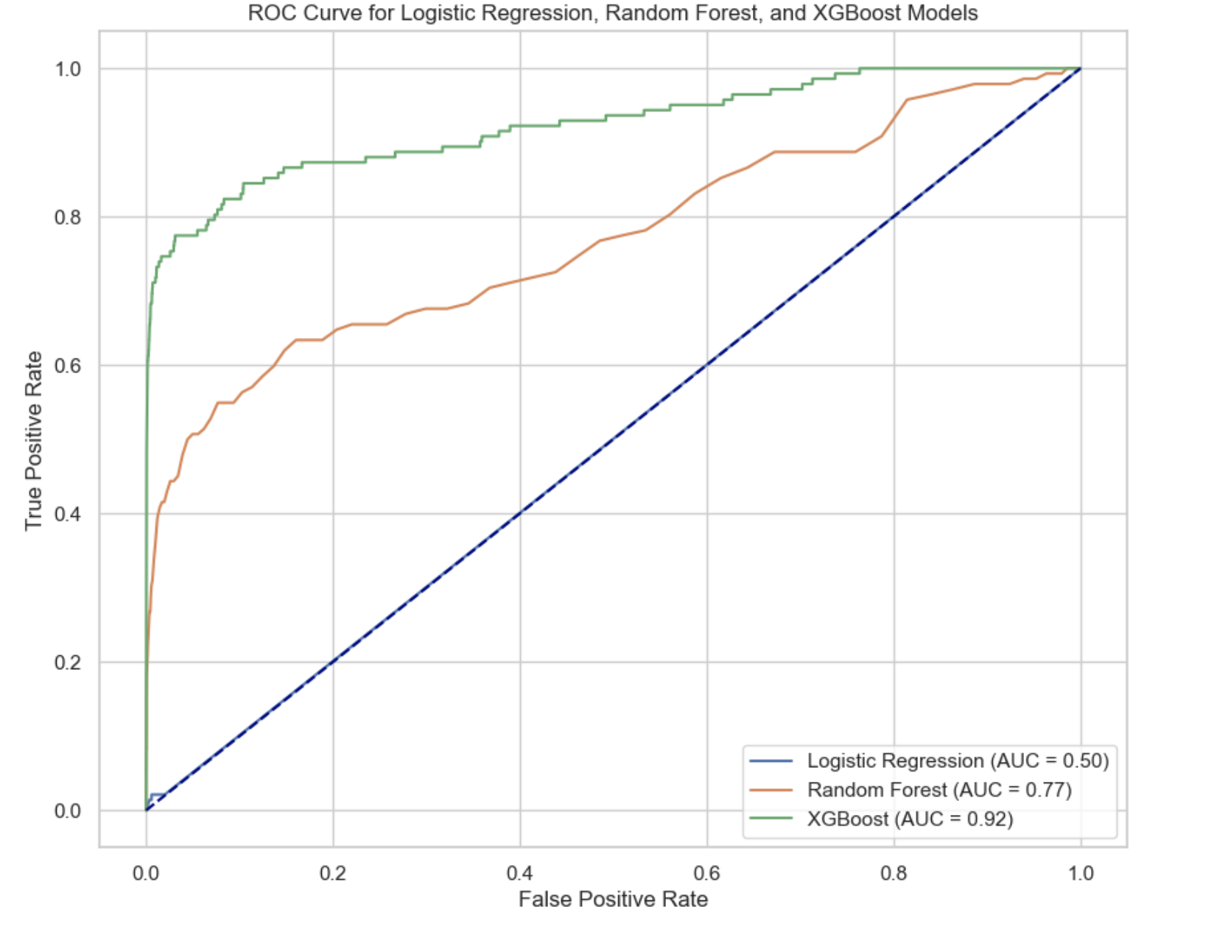

Model Comparison and Evaluation
Accuracy
99% in logistic regression; 90% in Random Forest
AUC-ROC
XGBoost led with 0.92 AUC. Best overall fraud detection performance.

Slide 11

Conclusion
1
Model Selection
2
Limitations
XGBoost emerged as the top performer. Balanced high AUC score with good interpretability.
Model struggles with new fraud patterns. Continuous retraining and monitoring are essential.

Slide 12
Future Works
1
2
3
compare models using other tuning methods like random search and bayesian optimisation
using advanced models like neural netwoks or ensemble (stacking/voting)
Feature engineering

